Slide 1
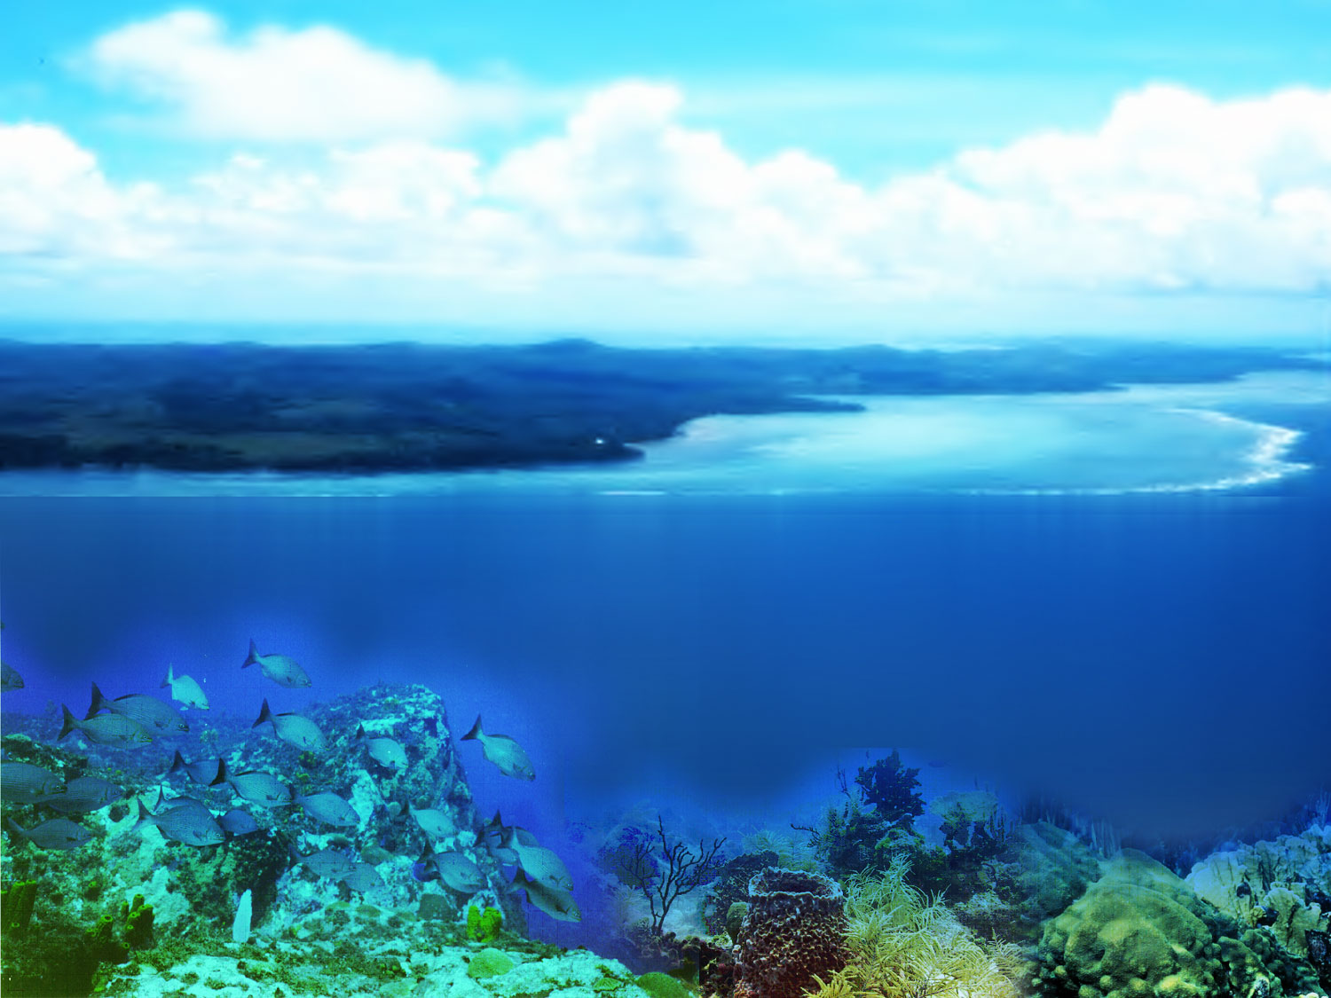
The Role of Standards in Integrating Environmental Microbiology and Human Health
20th Genomic Standards Consortium Meeting
University of California, San Diego
May 3, 2018
Rita R. Colwell, Ph.D., D.Sc.
Distinguished University Professor
University of Maryland College Park
and
Johns Hopkins Bloomberg School of Public Health
Design by: NSF/ A. Jeon Credit: Dr. James P. McVey, NOAA

Slide 2
Major technological developments in microbial systematics and ecology over the past half century.
Evolution
of
Molecular
Systemactics

Slide 4

Water-related diseases
Cases per year Deaths per year
Amoebiasis
Arsenic
Diarrhoeal disease,
Including cholera
Dracunuliasis (guinea worm)
Fluorosis
Giardiasis
Hepatitis A
Intestinal helminths
Malaria
Schistosomiasis
Trachoma
Typhoid
48,000,000
28-35m exposed to drinking
water with elevated levels
1.5 billion
> 5000
26 million (China)
500,000
1,500,00
133,000,000
396,000,000
160,000,000
500,000,000
500,000
110,000
1,800,000
-
-
Low
-
9400
1,300,000
> 10,000
-
25,000
West Virginia University
Civil and Environmental Engineering

Slide 5
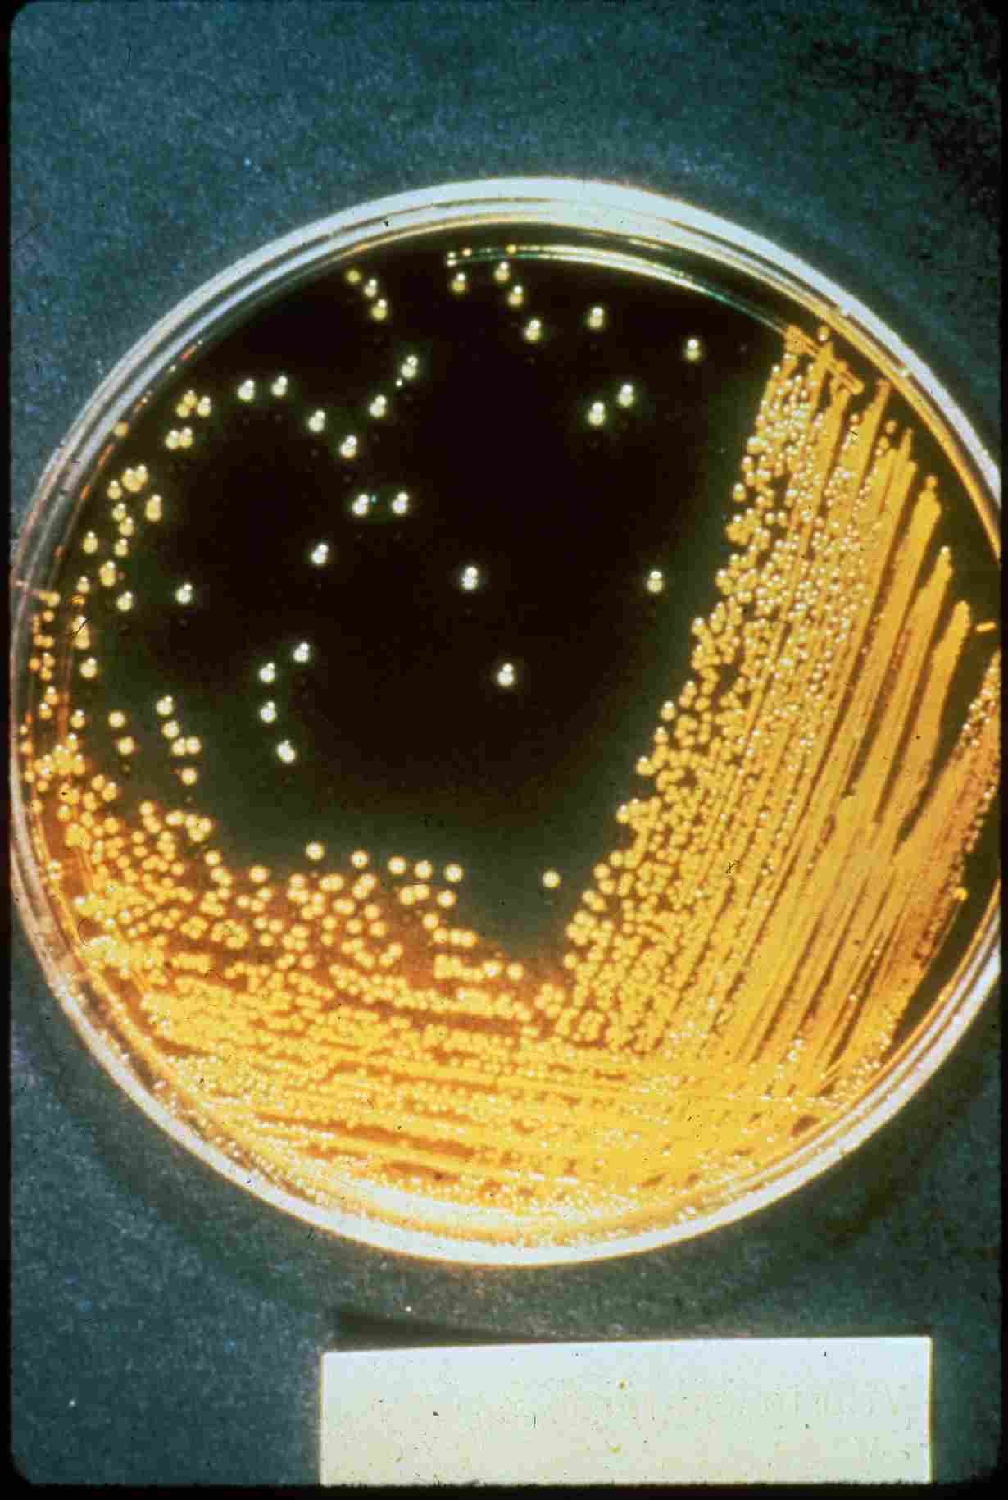
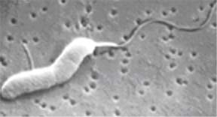
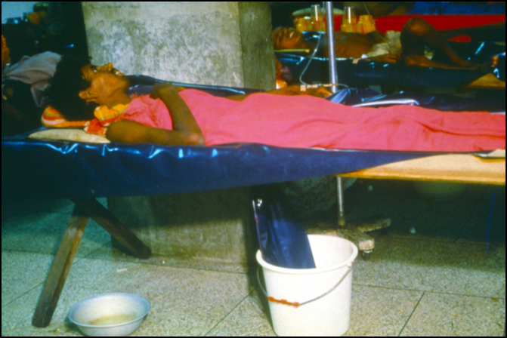
Notes:
5

Slide 6
1965-1975 An early contribution of marine microbiology to human health: Determination of the Vibrio cholerae life cycle

Slide 7
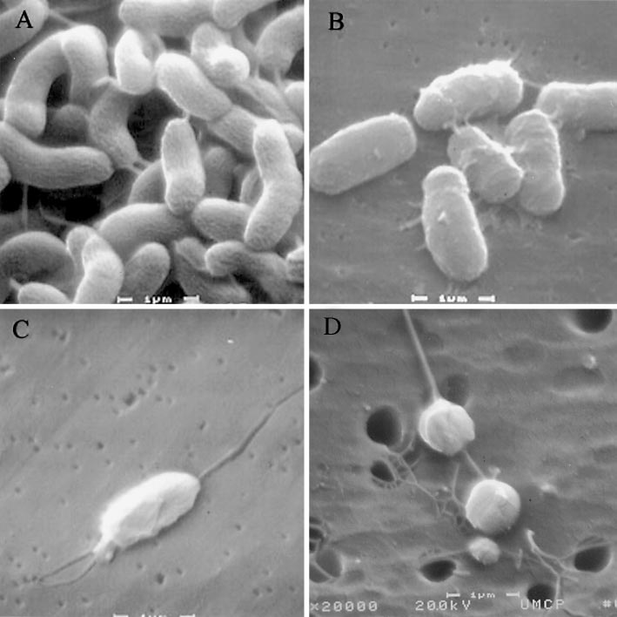
Solving the mystery of the “viable but non-culturable (VBNC)” bacteria
A curiosity – all the bacteria don’t grow in laboratory culture
Now we can see them

Slide 8
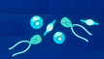

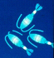



1975 Model for the Transmission of
Vibrio Cholerae from the Environment to Humans
Physical & Chemical
Characteristics of Water
temperature
sunlight
rainfall
pH
dissolved oxygen
salinity & nutrients
First Responders in the Spring months
(increased sunlight and
warmer temperatures)
algae and phytoplankton
blooms
Followed by Zooplankton blooms
Vibrios in non-culturable state in
and on zooplankton. (Commensal
or symbiotic)
annual cycle
Fecal shedding from cholera victim
transfers V. cholerae to water, food, and fomites
V. Cholerae detectable in both the viable and the viable but non-culturable state in the water column in summer months
Transmission of V. cholerae
to humans via ingested water containing
colonized copepods and free swimming
V. cholerae cells. (summer months)

Slide 9
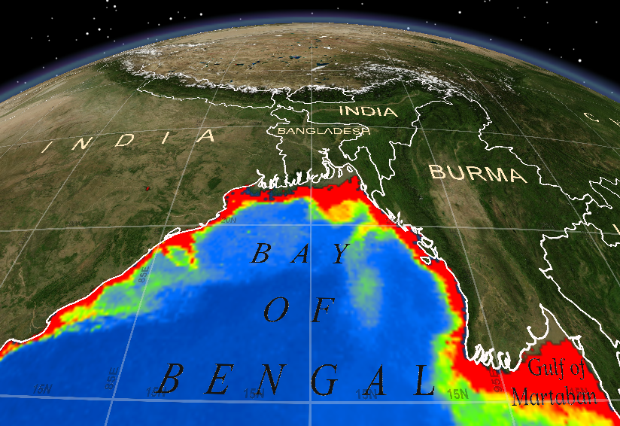
Work begins in Bangladesh in 1975
Dan Zimble, ESRI Inc.

Slide 10
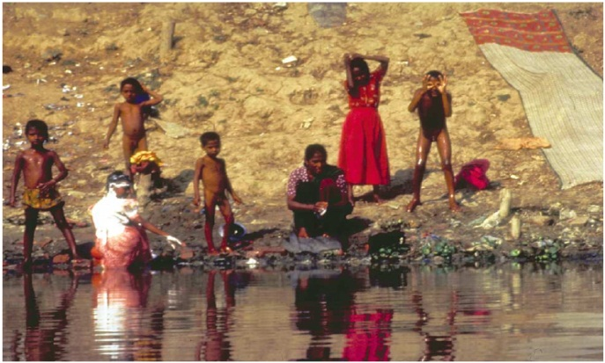
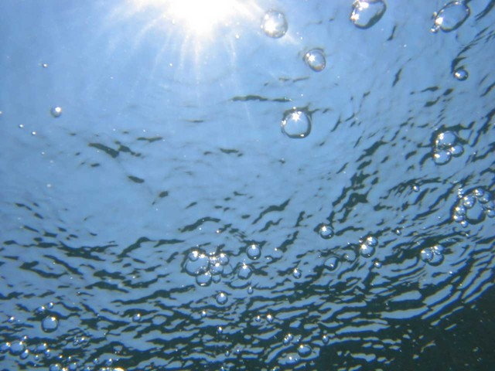
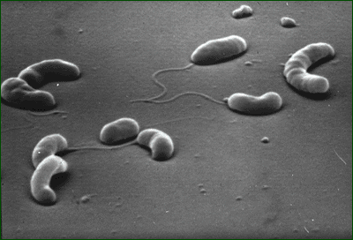
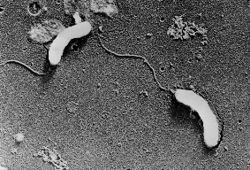
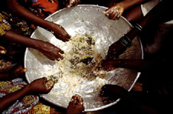
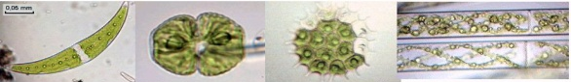
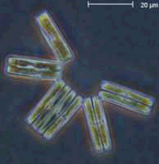
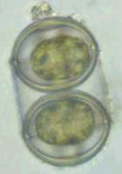
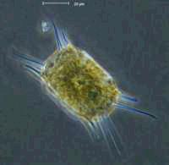
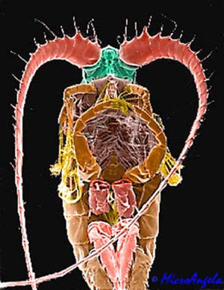
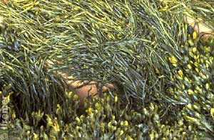
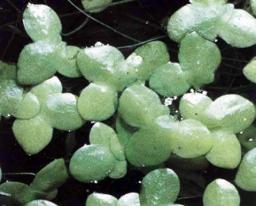
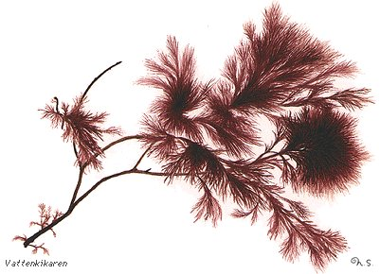

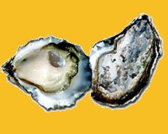
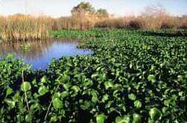
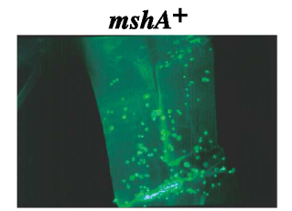
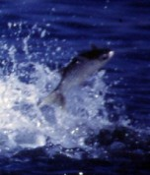
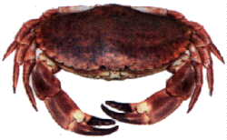
Bangladesh Model of Cholera source and Transmission
G. Constantin de Magny

Slide 11
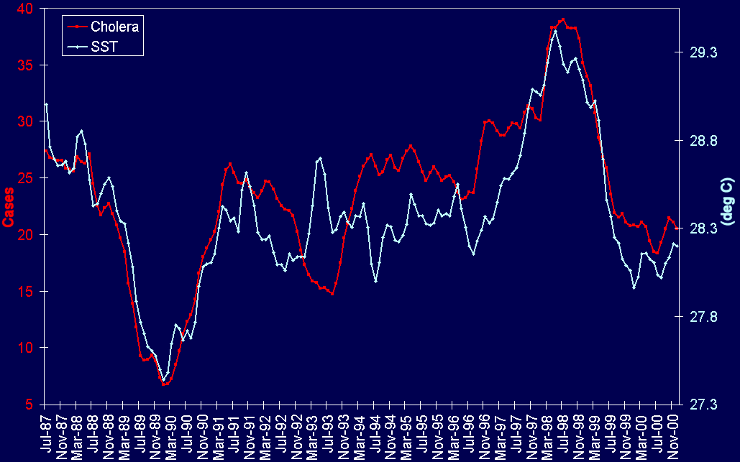
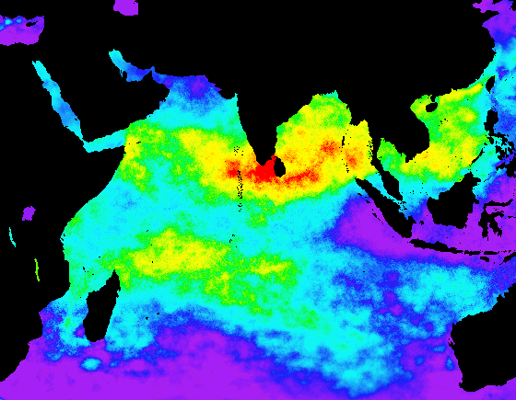
Cholera and SST in the Indian Ocean 1985 - 2000
Six-month SST lead: R² = 0.72
R²
0
0.6+
Lobitz et al., 2000, PNAS Vol. 97, No. 4 pp. 1438-1443
Notes:
11

Slide 12
Results employing an improved predictive model
Kolkata: Significant and positive relationship between cholera and CHL(t) and Rain(t).
Matlab: Significant and positive relationship between cholera and Chl(t-1).
KOLKATA
+1 mg.m⁻³ in CHL(t) => +32.5% in number of cholera cases (95% CI 8.3%-62.0%)
+1 mm.day⁻¹ in Rain(t) => +6.5% in number of cholera cases (95% CI 1.6%-11.7%)
MATLAB
+1 mg.m⁻³ in CHL(t-1) => +31.4% in number of cholera cases (95% CI 13.0%-52.7%)
Constantin de Magny et al., 2008, PNAS

Slide 13
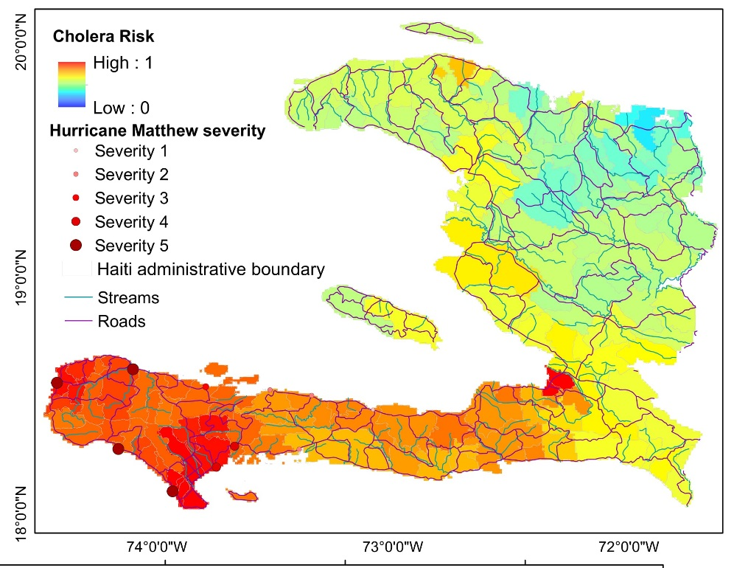
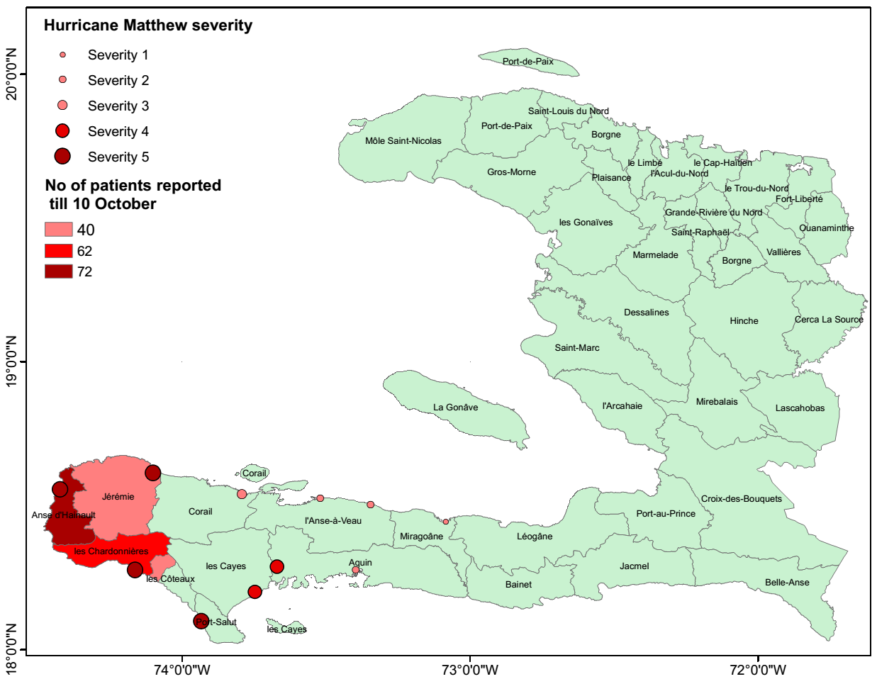
Predicted Cholera risk areas in
Haiti for December 2016
Actual Cholera (number of cholera patients reported) in Haiti (December 2016)
© Jutla/Colwell

Slide 14
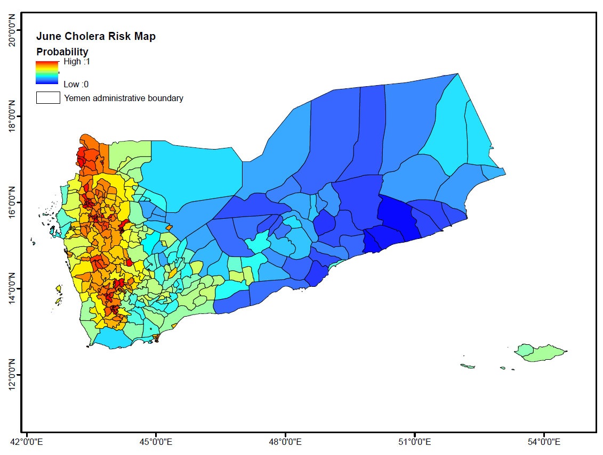
Real-time cholera prediction for Yemen, 2017
Risk estimated on May 30th, 2017.
© Jutla/Colwell

Slide 15
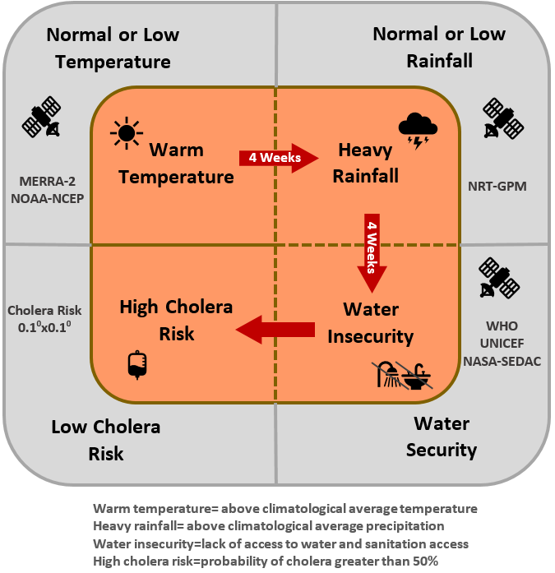
Current Epidemic Cholera Model and satellite data source
Figure 1: Earth observations for prediction of epidemic cholera
© Jutla/Colwell

Slide 16
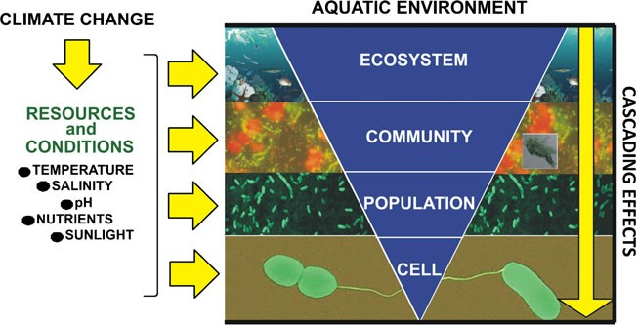
Figure 1. Simplified overview of the impact of climate change on Vibrios in the aquatic environment. Climate change is affecting ecological resources and conditions required by biological species. These are directly influencing Vibrio cells and populations (e.g., Vibrio metabolism and growth) as well as higher levels of organization of the aquatic system (e.g., living communities and the physicochemical environment). The impact of climate change on the upper levels of ecosystem organization may ultimately trigger indirect cascading effects that could have profound repercussion on the Vibrios (e.g., by affecting Vibrio environmental reservoirs and trophic interactions)

Slide 17
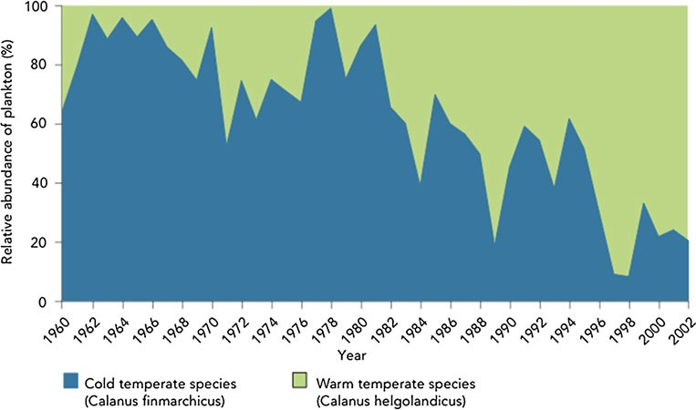
Figure 2. Long-term changes in plankton assemblages in the North Atlantic and North Sea spanning four decades. Plankton data recorded by the CPR survey in the North Atlantic and North Sea show the increase in dominance of warm-water copepod species (Calanus helgolandicus) (green) and concomitant decrease of cold-water species (Calanus finmarchicus) over the period 1960–2002. Copyright© 2010 Sir Alister Hardy Foundation for Ocean Science. All Rights Reserved. SAHFOS

Slide 18
Vezzulli et al. Proc. Natl. Acad. Sci. USA 2016 113 (34) E5062-E5071 doi:10.1073/pnas.1609157113
Notes:
Figure 1 revised

Slide 19
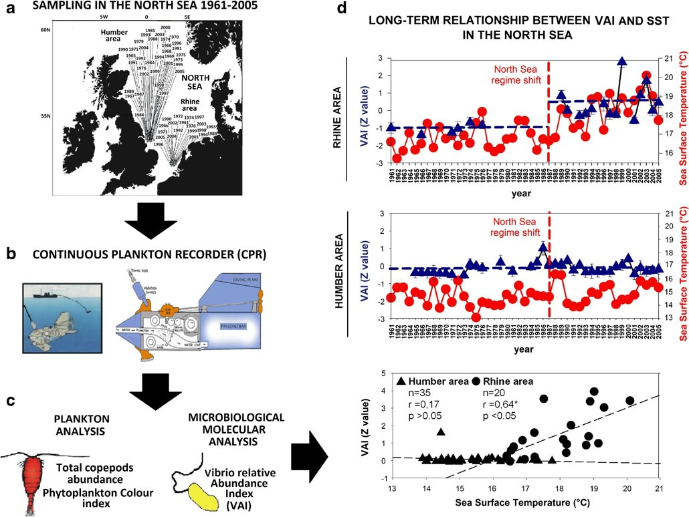
Figure 3 Retrospective assessment of long-term relative abundance of Vibrios in the North Sea. Formalin-fixed plankton samples were col- lected by the CPR survey off the Rhine and Humber estuaries, in August, over the period 1961 to 2005 (a). CPR samples were collected by the continuous plankton recorder (b). Back in the laboratory, the silk containing the formalin-fixed plankton was cut into blocks and microbiological molecular analyses were carried out to assess Vibrio-relative abundance (see Vezzulli et al. for details) (c). Phytoplankton and zooplankton analysis was also carried out following standard CPR methodology (c). Long-term variation in standardized (Z) VAI (triangles; error bars indicate standard deviation, n =5) and SST (circles) for 1961–2005 off the Rhine and Humber estuaries in the North Sea (d). Vertical line =regime shift step change in temperature after 1987. Horizontal lines=average VAI values. The Pearson correlation analysis between VAI and SST in the North Sea (Pearson's correlation on pooled data; n =55; r= 0.27*; P<0.05) (d). Z values are obtained by subtracting the population mean and dividing the difference by the standard deviation. Modified from Vezzulli et al.

Slide 20
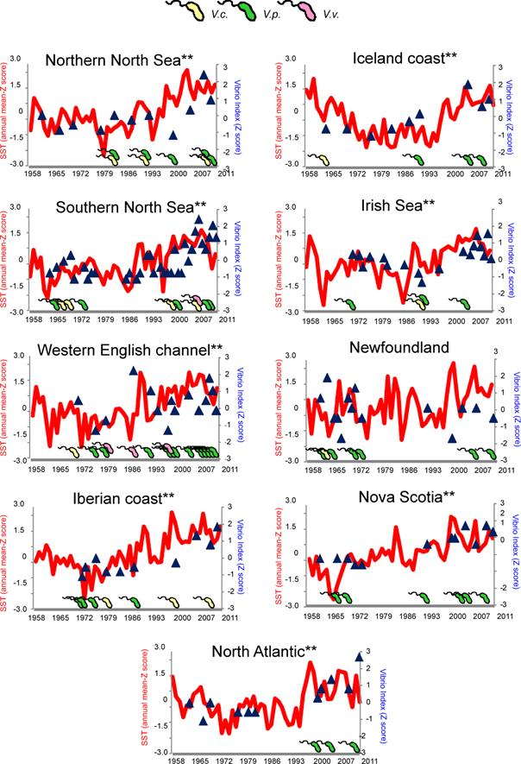
Notes:
Figure 3 Multidecadal relationship between Vibrio prokaryote abundance and SST in the temperate North Atlantic and North Sea. Standardized (Z) Vibrio index (VAI) data (blue triangles) are superimposed to standardized (Z) SST monthly means time series data (red line) for nine geographic areas in the temperate North Atlantic. Presence of the human pathogenic species V. cholerae (V.c.-yellow bacterial cell), V. parahaemolyticus (V.p.- green bacterial cell) and V. vulnificus (V.v-pink bacterial cell) is showed. Z values were obtained by subtracting population mean and dividing the difference by the standard deviation. **Pearson correlation analysis, P<0.05.

Slide 21
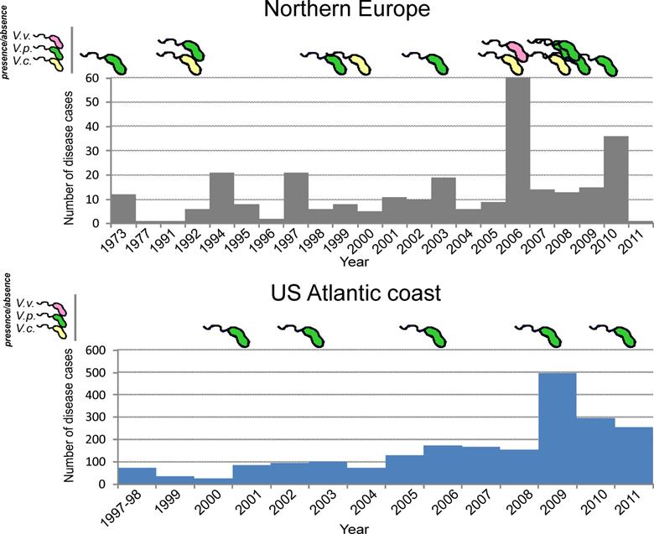
Vezzulli et al. Proc. Natl. Acad. Sci. USA 2016 113 (34) E5062-E5071 doi:10.1073/pnas.1609157113
Notes:
Figure 5 Multidecadal relationship between Vibrio prokaryote abundance, plankton abundance and plankton community structure in the North Sea for 1958-2011. A. Standardized (Z) Vibrio index (VAI) data (blue triangles) are superimposed to broad-scale submodel monthly time series for the phytoplankton color index (PCI, green line) and total copepod (TotCop, brown line) data for the northern and southern North Sea. Presence of human pathogenic species, V. cholerae (V.c.-yellow bacterial cells), V. parahaemolyticus (V.p.- green bacterial cell) and V. vulnificus (V.v-pink bacterial cell) is shown. Pearson correlation analysis was performed between VAI and corresponding plankton submodel data for the month of August, 1958 to 2011. B. Month by year contour plots of plankton abundance for the ten most abundant phyto- and zooplankton species in the northern and southern North Sea, according to Johns and Reid (80). PHYTOPLANKTON: Ceratium fusus (C.fusus), Ceratium furca (C.furca), Ceratium tripos (C.tripos), Ceratium lineatum (C.lin), Ceratium macroceros (C.macro), Ceratium longipes (C.long), Ceratium horridum (C.horr), Thalassiosira spp. (Thalass), Chaetoceros(Hyalochaete) spp. (Hyal), Chaetoceros(Phaeoceros) spp. (Phaeo), Rhizosolenia imbricata (R.Imb); ZOOPLANKTON: Calanus Traverse (CalTrav), Calanus I-IV (CalI-IV), Calanus finmarchicus (Cal.fin), Calanus helgolandicus (Cal.hel), Para-Pseudocalanus spp. (PPcal), Echinoderm larvae (Ech.larv), Acartia spp. (Acartia), Evadne spp. (Evadne), Oithona spp. (Oithona), Pseudocalanus adult (Pcal.ad), Podon spp. (Podon), Temora longicornis (Temora l).

Slide 22
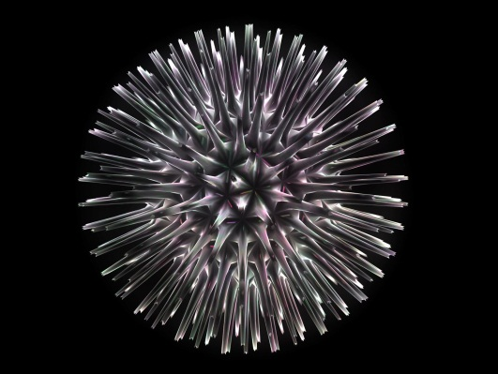
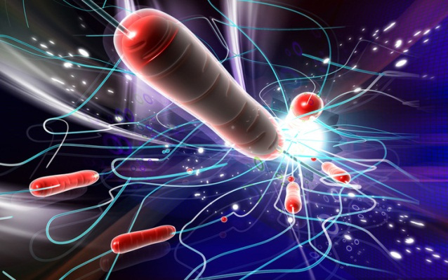
Next Gen Sequencing and Metagenomics IDENTIFICATION
2007 – present
www.cosmosid.com

Slide 23
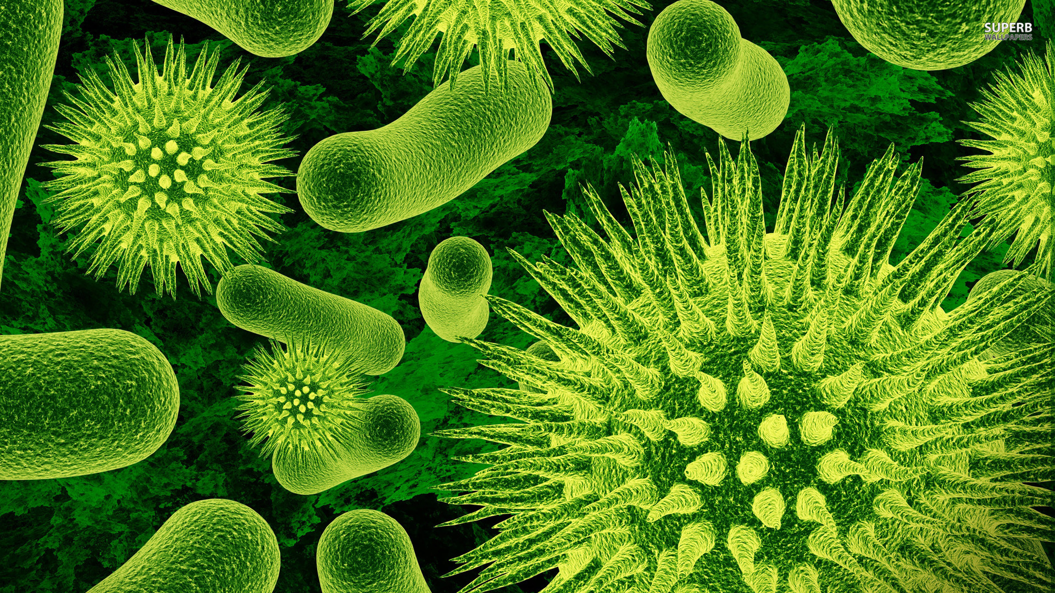
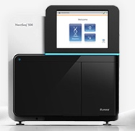




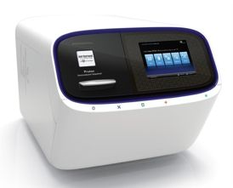

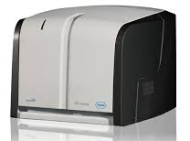
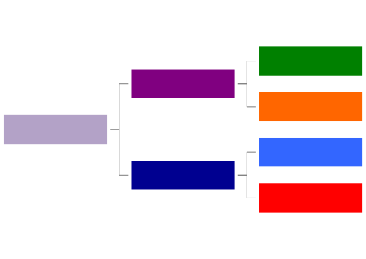
How It Works
Biological specimen
Community DNA
DNA Sequencing
GenBook Biomarker Matching
GenBook Database
Raw Sequence Reads
Identified Bacteria
GenBook AR/VF Library
CIP^{R}
Microbial Identification & Pathogen Characterization
Tet^{R}
ctxA
mecA

Slide 24
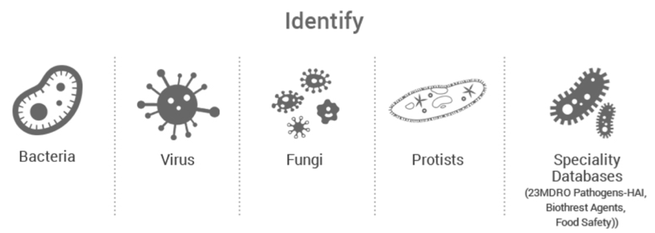
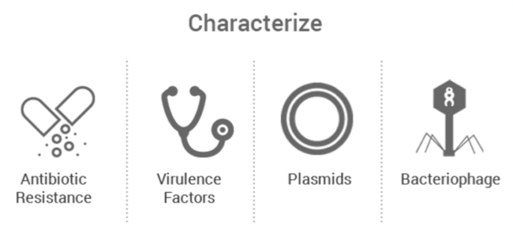
Powerful Bioinformatics with Curated Genome Databases
Most comprehensive and world’s largest curated databases (150,000+ genomes and gene sequences)
Organized as phylogenetic trees
Two types of biomarkers:
Unique to the organism, and
Shared across the phylogenetic lineage in the tree
Customizable Databases

Slide 25

Best in Class Performance
species
Strain level accuracy
Unrivaled precision and recall
World’s Largest Curated Database
Phylogenetic
Fastest analysis
sub-species
cosmosid.com/blog-cosmosid/benchmarking-genome-biology-2017

Slide 26
Infectious Disease in the Genomics Era
Necrotizing fasciitis

Slide 27
Polymicrobial Infection resulting in Necrotizing Fasciitis
Neighbor-joining tree using 2,514 conserved full length predicted proteins
Notes:
Late in 2014, Dr. Chopra and Dr. Colwell, founder of CosmosID, met each other in a scientific conference and discussed about the potential use of CosmosID GENIUS solution to identify and differentiate individual strains in mixed infections like this.
As a result an animal experiment was designed to better understand the infection dynamics and the role of multiple strains in mixed infections, using GENIUS.
Dr. Chopra and his colleagues conducted the animal experiment, by injected mixed culture of NF1-NF4 strains intra muscularly (as i.m. injection produces NF symptoms very well)
All five mice injected with the mixed culture of NF-1 to -4 died by the time of muscle tissue, spleen and liver samples were collected (24 hrp.i.).
They did species specific PCR which shows the presence of Aeromonas DNA in all three samples types
The extracted DNA from these samples were subjected to whole genome shotgun sequencing using Illumina MiSeq at FDA, and sequenced data were analyzed by Genius software at CosmosID.

Slide 28
Strain level identification revealed only a single strain
migrated to the spleen and liver
Relative distribution of four Aeromonas hydrophila strains NF1, 2, 3, and 4 into different metagenomic datasets derived from muscle, spleen and liver samples
Notes:
This analysis involved creation of a new database, where we incorporated the four NF strains into our existing curated bacterial database, which contain about 4800 bacterial genomes. Our automated process placed these four NF strains into the Aeromonas clade along with other A. hydrophila present in the database and identified unique patterns for each of the four strains (41483, 147, 47, and 63 for NF1, 2, 3, and 4 respectively). The large number of patterns unique to NF1 indicates that it's quite different than other three strains which appears to be very closely related but yet distinguishable by few dozens of unique biomarkers.
We analyzed the thirteen metagenomic datasets against these newly constructed database, and the result of our analysis indicated presence of multiple strains in the muscle tissue but too our surprise both spleen and liver were occupied by only NF1.
This very interesting but unexpected findings.

Slide 29
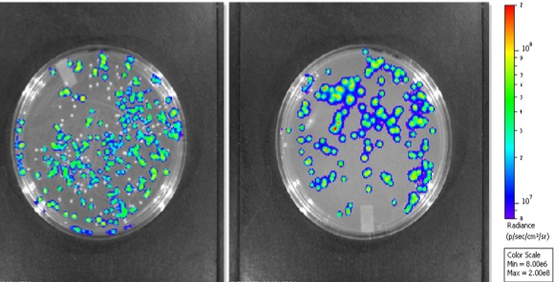
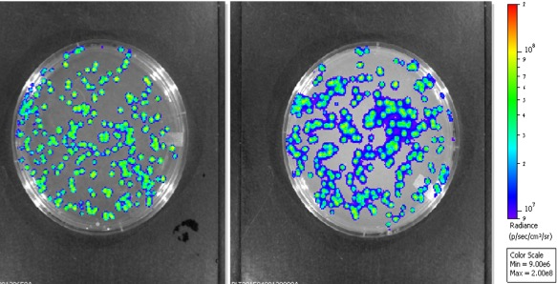
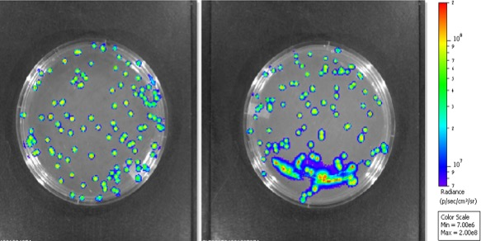
Mixed infection of Aeromonas isolates (NF1, NF2) in mice proved only one strain disseminates to the spleen and liver
LB plate
Kanamycin plate
Ability to provide strain level ID facilitated better understanding of the dynamics of mixed infections:
NF2
NF1
NF1
Muscle
exoA production leads to dissemination of NF1
Strain NF2 appears to facilitate NF1 dissemination in mixed infection
Not yet determined factor(s) produced by NF1 would prevent NF2 dissemination or block its proliferation
LB plate
Kanamycin plate
NF1
Spleen
LB plate
Kanamycin plate
NF1
Liver
Notes:
So to trace the dissemination of NF1, and to validate the result of GENIUS, NF1 was constructed with luciferase and kanamycin resistant gene and mixed with NF2, and injected in mice.
And we see the dissemination pattern of NF1 and NF2
both Nf1 and Nf2 were recovered from muscle tissue but, Spleen and Liver contains only NF1 .
This reaffirmed our findings, and helped researched to explain the observation in a biological context.

Slide 30
Strain interaction in this mixed infection causing necrotizing fascitis
Dissemination to peripheral organs
Dissemination to peripheral organs

Slide 31
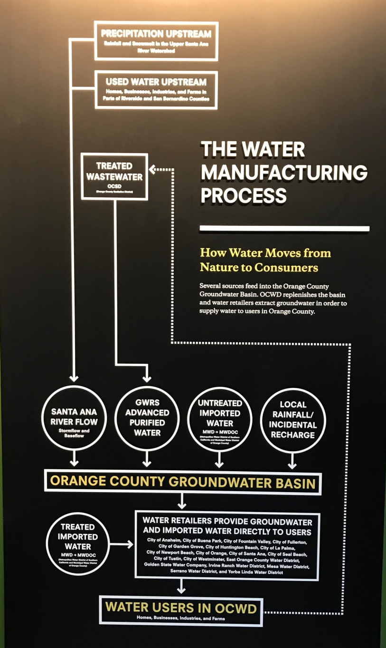

Safe Drinking Water: Ensuring Microbial Quality in
Water Manufacturing for Orange County, CA
The influent, secondary treated municipal wastewater of the AWPF treatment train is
purified by a three-step process:
microfiltration,
reverse osmosis, and
ultraviolet (UV) light with hydrogen peroxide.
Initially the wastewater is screened at 4mm,
Sodium hypochlorite as disinfectant is added prior to microfiltration.
Hydrogen peroxide (H₂O₂) is added before UV treatment.
The decarbonators remove CO₂ and raise the pH; addition of lime further stabilizes the purified water.

Slide 32
Sampling Microbial Quality at selected steps of
the Water Manufacturing Process
Sodium Hypochlorite
H₂O₂
influent
AWPF final
product
water
Filter
Screens
Microfiltration (MF)
process
Reverse Osmosis (RO)
process
Ultraviolet
Irradiation System
lime
decarbonation
Notes:
Distribution of antibiotic resistance genes (ARGs) in influent Q1-water, membrane filter (MF) and reverse osmosis (RO)-biofilm samples. Presence, absence, and five shared ARG sequences were identified in the MF and RO-biofilm. All ARG sequences compared represent complete and/or partial gene coverage for identification of ARGs.
Stepwise reduction of antibiotic resistance coding genes (ARGs) identified in MF and RO-biofilm and in influent Q1.
M. Leddy, N. Hasan, J. Cotruvo and R. Colwell, 2017. Manuscript under review.

Slide 33






Multi-kingdom Microbiome analyses
Bacteria
Virus and Bacteriophages
Fungi
Protists
Community Resistome
Virulence Genes
Influent (Q1) Water Sample

Slide 34

Stepwise reduction of bacterial genera from MF to RO
Microfiltration (MF)
Reverse Osmosis (RO)
Relative Abundance—%

Slide 35




Viral diversity
Genera of virus and phage DNA & cDNA
DNA
cDNA
Q1
both
- Rhino virus branch
- Pepper mild motile virus (PMMoV)
- E. coli phage
- Adeno virus branch
MF_biofilm
- PMMoV
- Adeno virus branch
- E. coli phage
RO_biofilm
Predominately bacteriophage identified in all samples

Slide 36

Distribution of antibiotic resistance genes (ARGs) and stepwise reduction of ARG’S in MF and RO-biofilms
(a)
RO
Input water from sewage treatment plant (Q1)
Microfiltration (MF) biofilm
Reverse Osmosis (RO) - biofilm
N=141
N=85
Q1
MF
N=9
Q1-water
MF-biofilm
RO-biofilm
Notes:
Distribution of antibiotic resistance genes (ARGs) in influent Q1-water, membrane filter (MF) and reverse osmosis (RO)-biofilm samples. Presence, absence, and five shared ARG sequences were identified in the MF and RO-biofilm. All ARG sequences compared represent complete and/or partial gene coverage for identification of ARGs.
Stepwise reduction of antibiotic resistance coding genes (ARGs) identified in MF and RO-biofilm and in influent Q1.
M. Leddy, N. Hasan, J. Cotruvo and R. Colwell, 2017. Manuscript under review.

Slide 37

Diversity in the Human Microbiome
Biodiversity and functional genomics in the human microbiome
Morgan et al (2013) Trends in Genetics. http://doi.org/10.1016/j.tig.2012.09.005

Slide 38


The Concept of Community Resistome
First proposed by Gerard D. Wright (2007) Nature Review.
Refers to the collection of all the antibiotic resistance genes and their precursors carried by a community of both pathogenic and non-pathogenic commensal bacteria.
The complete set of antibiotic resistance genes is composed of four different types of genes:
Resistance genes found on pathogenic bacteria
Resistance genes found on antibiotic producers
Cryptic resistance genes
Precursor genes
Metagenomics analytical approach can provide rapid and comprehensive profiling of community resistome
Notes:
The resistome is a proposed expression by Gerard D. Wright[1] for the collection of all the antibiotic resistance genes and their precursors in both pathogenic and non-pathogenic bacteria.
This complete set of antibiotic resistance genes is composed of four different types of genes:
Resistance genes found on pathogenic bacteria. These are the fewest but also the most problematic ones at present.
Resistance genes found on antibiotic producers. The microorganisms such as soil-dwelling bacteria and fungi that naturally produce antibiotics have their own protection mechanisms[2] to avoid the adverse effects of the antibiotics on themselves. The genes which code for these resistances are a strong source[3] for the pathogenic bacteria.
Cryptic resistance genes. These genes are embedded in the bacterial chromosome but do not obviously confer resistance, because their level of expression is usually low or they are not expressed.
Precursor genes. These genes do not confer antibiotic resistance. However they encode proteins that confer to some kind of basal level activity against the antibiotic molecule or have affinity to the molecule. In both cases this interaction may evolve to a full resistance gene given the appropriate selection pressure.

Slide 39
Community Resistome: soil sample

Slide 40
Community resistome of different water sources
Water sources:
Processing Plant
Tidal Freshwater River
Tidal Brackish River
Reclaimed Water
Pond Water
Nontidal Freshwater Creek
ARGs:

Slide 41
Microbiome Analysis of
Acute Diarrheal Patients
Compared with Healthy Individuals
Manuscript in preparation (2018)

Slide 42

Diarrheal Disease Study carried out with the National Institute of Cholera and Enteric Disease, Kolkata, India
www.niced.org.ind

Slide 43
Microbiome Analysis of Acute Diarrheal Patients Compared with Healthy Individuals
Bacteria
Vibrio cholerae
Vibrio parahaemolyticus
Vibrio fluvialis
Aeromonas spp.
Campylobacter jejuni
Campylobacter coli
Shigella
Salmonella
Escherichia coli
Parasites
Giardia lamblia
Cryptosporidium parvum
Entamoeba histolytica
Blastocystis hominis
Viruses
Rotavirus
Adenovirus
Norovirus
Sapovirus
Astrovirus
Total # of NICED samples: 74
Indian Healthy Control (HC): 20
Sick with Unknown Etiology (UE): 28
Sick with Known Etiology (KE): 26
Healthy Human Microbiome Project (HMP): 20
In collaboration with the National Institute of Cholera and Enteric Disease (NICED), Calcutta, India
Notes:
@ 2% Surveillance (every 50th patient) at the National Institute of Cholera and Enteric Diseases (NICED), Calcutta, India

Slide 44

Metagenomic results showed Overrepresentation of Subpopulation comprising enteric pathogens in Diarrheal Patients
(healthy)
γ- Proteobacteria – Firmicutes - Bacteroidetes

Slide 45
Global Healthy Gut Microbiome

Slide 46
Healthy Gut Microbiome Across Countries and Cultures
~10 countries
>600 samples
Bacteroidetes - Firmicutes – Proteobacteria - Actinobacteria
Preliminary Data - 2017

Slide 47
Healthy Gut Microbiome Across Countries
China
Spain
US
Japan
Denmark
Native American
Rural India
India
Tanzania
Preliminary Data
Bacteroidetes - Firmicutes – Proteobacteria - Actinobacteria

Slide 48
Microbiome: Protists
Country
Tanzania
}
Protist parasite
Preliminary Data
- 2017

Slide 49

What is Healthy?
PCA Analysis on app.cosmosid.com

Slide 50

Is healthy really so different?
PCA Analysis on app.cosmosid.com

Slide 51

Or, is Healthy more similar than we think?
PCA Analysis on app.cosmosid.com

Slide 52

A Simple, Sustainable
Method for
Reducing Cholera
Notes:
52

Slide 53



A simple, sustainable method for preventing cholera

Slide 54
Full Study Results
1.40
1.20
1.00
0.80
0.60
0.40
0.20
0.00
Cases of Cholera Per 1000 Population
Control
Sari
Nylon
Test Group
Notes:
54

Slide 55

Safe water is a global challenge
Courtesy of GB Nair, NICED, Kolkata, India

Slide 56

“When one tugs at a single thing in
nature, he finds it hitched to the rest of the universe.”
John Muir
(1838-1914)

Slide 57
Genomics Team 2017-2020
NICED:
G. Balakrish Nair
Thandavarayan Ramamurthy
University of Maryland:
Shah M. Rashed
Seon Young Choi
Anwar Huq
CosmosID:
Nur A. Hasan
Poorani Subramanian
Kelly Moffat
Huai Li
Brian Fanelli
Manoj Dadlani
Orange County Water District
Menu Leddy
Consultant
Joseph Cotruvo
West Virginia University
Antarpreet Jutla
Amy J. Mathers, UVA
Ashok Chopra, University of Texas
Medical Branch
Chris Grim, FDA

Slide 58


